Slide 1

TEAM 15 TEAM 15 scale human capacity to power data & reporting
#NurseHack4health

Slide 2




How might we Increase the sense of safety for school re-opening?
School Nurse Sally
Petered-Out Parent
Stay-Safe-Student
Side-Lined Nursing Student
Wants to get back to school
Fear of contracting illness
Before COVID... ratio of nurse to students 1:750, 1:2000+
Death by screenings/ paperwork, in information silo.
At capacity!
Lost jobs, can't return without child-care or juggling WFH
Campuses closed
Unable to complete required clinical experiences
Notes:
School nurses – not connected with EHR, public health, pediatrician, contact tracing.

Slide 3
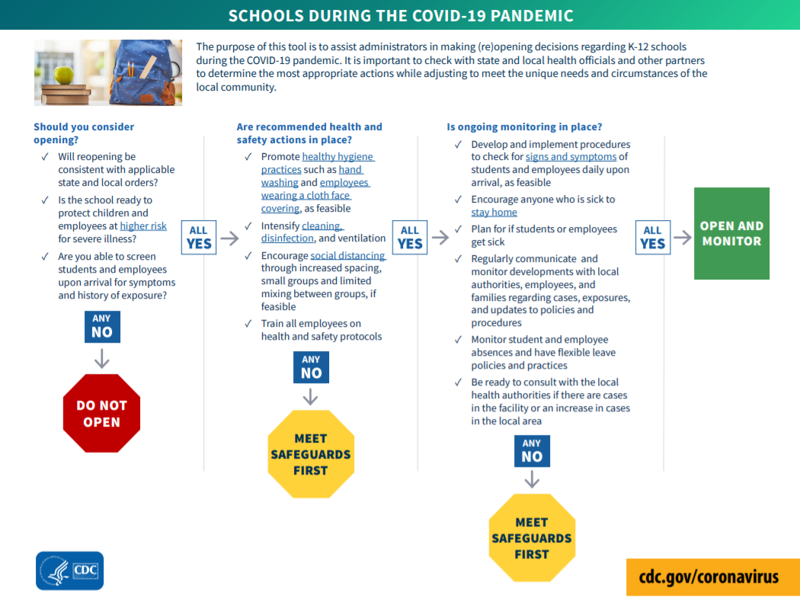
YESTERDAY THE CDC RELEASED BACK TO SCHOOL GUIDELINES
Notes:
If you can't met over half a dozen screening, monitoring, sanitizing, and behavioral changes in place, you should reconsider opening

Slide 4
The Problem
Looks good on paper!
School nurse workforce is outnumbered and under-resourced.
A population of nursing students willing to help but lacks mobilization.
Tech alone is not the remedy.
Parents are fried.
NSNA reported last month they will need an additional 10,000 school nurses.
Notes:
To safely re-open schools post-COVID, school nurses and parents will be on the front lines of communication and data entry about which students can return to school or which need to be sent home, but parents and school nurses are both the stretched the most thin and chronically under-resourced
No one knows the child better than the parents. But they are overwhelmed with everchanging safety messages.
One school nurse cannot retrieve daily parent-sent data about student health in the hours before school start times, nor can they humanly track or triage symptoms on all students during the day and coordinate care with parents, pediatricians, and emergency rooms.
Meanwhile side-lined nursing school students have been unable to complete clinical hours and are eager to get progress towards graduation

Slide 5
WHY can't WE SOLVE EVERYONE'S NEEDS WITH A SINGLE SOLUTON?
THE ANSWER IS TO LEVERAGE PEOPLE AND TECH TOGETHER
Notes:
We wondered....

Slide 6


THE people SOLUTION: the school nurse corps
<
School nurses can match with nursing students on a multi-sided platform
Nursing students can be "deployed" to help in a contactless, virtual capacity
Adds a needed reinforcement for school nurses to help triage and analyze data prior to school start times
Helps transform nursing education: Students learn more informatics and community health!
Notes:
School nurses need clinical hours, School nurses need triage support, Parents have questions and concerns about sending their child to school.

Slide 7
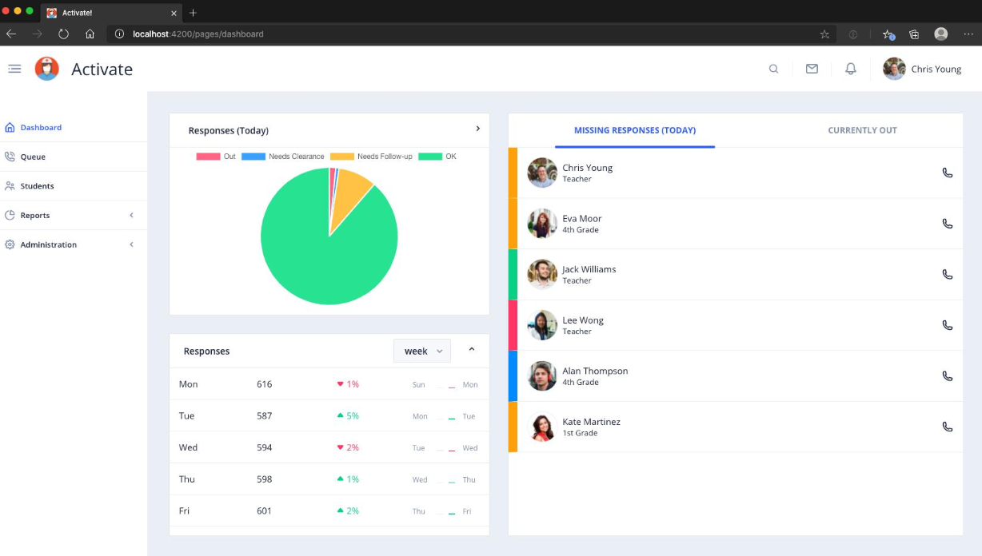
School nurses multiply their power and reach by becoming a NURSE COVID-19 SCREEENING TEAM
Notes:
School nurses need clinical hours, School nurses need triage support, Parents have questions and concerns about sending their child to school.

Slide 8
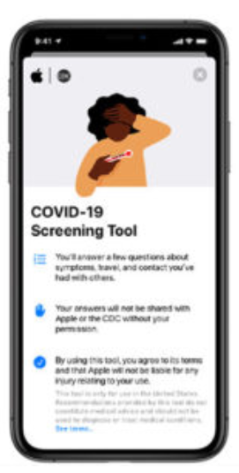

The tech solution: Mobile screening & rfid bracelets
Nursing students work before school opens to make sure student and teacher screening data is logged in so that bus drivers and school support can scan student RFID bracelets to know who is "cleared"
RFID affordable, safe, and provides easy access to ancillary staff
Nursing students can address those missing or follow up with contract tracers
Frees school nurse to be on site and focused on ad hoc issues
Parents, students, and teachers receive tech in a care package prior to school re-open
With multi-lingual resources and links to informational videos about new process
Arts, crafts, stickers to decorate RFID bracelet to engage kids in making their "own"
Reinforces trust and partnership between school and families, reduces ambiguity and anxiety
Notes:
RFID provides easy access to ancillary staff who are not in front of computers
on ad hoc issues – diabetes, asthma, ADHD and anaphylaxis allergies
or follow up with contract tracers – pediatricians, emergency rooms, dept of health

Slide 9

sustainability
School Safety
Over 56 million students attend school in the United States
Coronavirus predicted to impact schools over next 1 – 2 years
Our solution can be piloted this Fall
Demonstrate positive impact on reduction of missed school days, teacher absences, and community-acquired infections
Scalability
There are currently over 300,000 nursing students enrolled in the U.S.
In rural areas, can expand to include medical, pharmacy, PA, public health, social work students
Coronavirus has launched a new public health mindset for decades to come
Can be applied to business re-opening, restaurants, etc

Slide 10




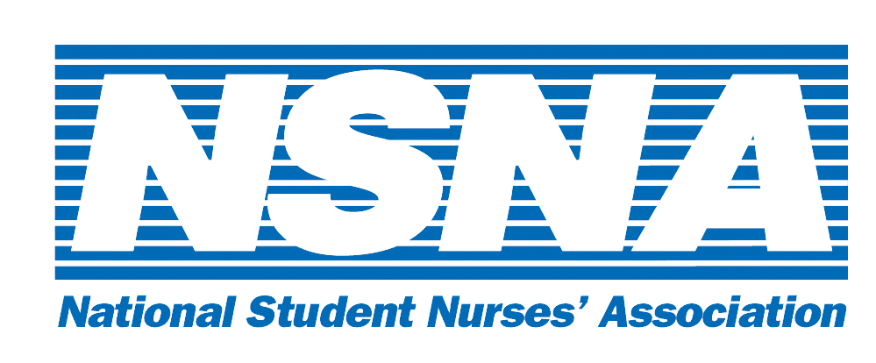




Business model
Non-Profit Consortium
Professional Partnership
Academic Partnership
Partnership with academic institutions
Individual student-clinician “sign-up” similar to gig-worker model
Tracks clinical hours
Notes:
Portion free and already available
RFID affordable / school administrative fees
App is free for over 30,000
API from app to dashboard
AMAZON....
A subscription model with pricing elements for each party involved makes this solution achievable for everyone and sustainable. Families pay a one-time annual fee for equipment. The school system pays a one-time fee for the platform. Because the system is cloud based they do not need additional IT resources. And the student nurses clinical rotation fees can be repurposed to support ther participation in the Corps.
K-12 e.g., National Association of School Nurses
Higher-ed e.g., American Association for Higher Education, National Student Nurse Association
Medical Professional Organizations e.g., American Nurses Association (ANA), American Medical Association (AMA), American Academy of Pediatrics (AAP),

Slide 11
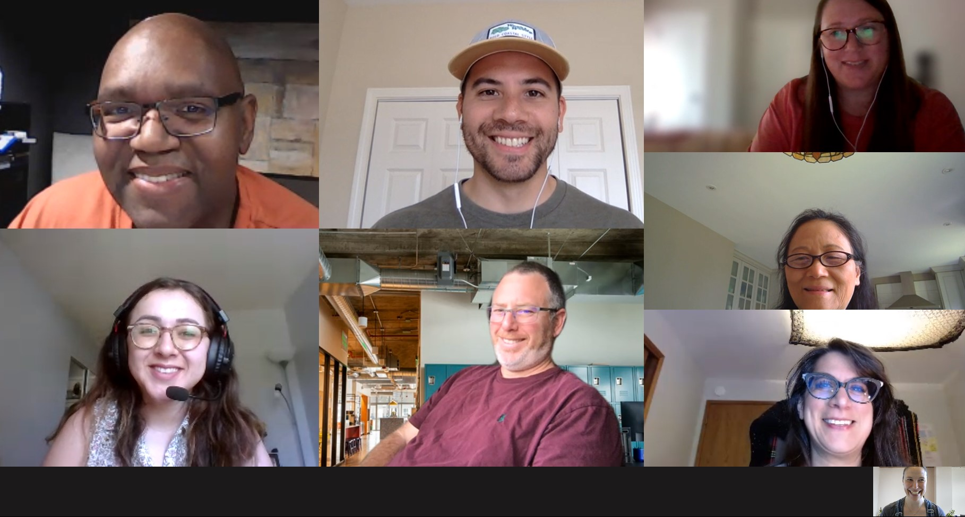

THANK YOU!
Our nation is unified that we need schools to operate safely so students can achieve their greatest potential.
Our solution is scalable and meets needs of school nurses, students, parents, and nursing students.
Can we count on your support?
School Nurses
Pao-Chu Tseng, PhD, RN, CSN
Lacey Sprague, WCCHD Medical Reserve Corps & Contact Tracer
Nurse Informaticists
LeAnthony Mathews, RN, MBA, MS
Blanca Badgett, MSN, BSN, RN
Ramona Ramadas, RN, BSN MHI
Joanna Seltzer Uribe, RN, MSN
Community Health Nurse
Pramila Thapa, RN, B.Ed PBsc.N, M.Sc Nursing, MPA, Nepal
Developer
Chris Young, Director of Development
Nurse Practitioner
Brian Goldenberg, FNP, RN

